Slide 1
Phonetic Transcription using Speech Recognition Technique Considering Variations in Pronunciation

Slide 2
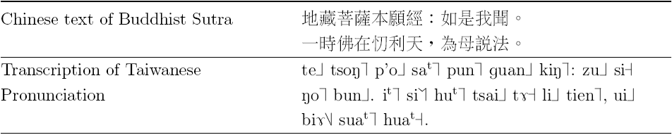

Motivation and problem
Target text is Buddhist Sutra in Taiwanese (Min-nan)
  Although the same Chinese character is used in different areas, the pronunciation may be very different
  Terse ancient style (文言文)
  Taiwanese has multiple pronunciations (MP) and pronunciation variation (PV)
The phonetic symbols used here are IPA followed by a digit representing one of several tone classes of the Taiwanese language

Slide 3
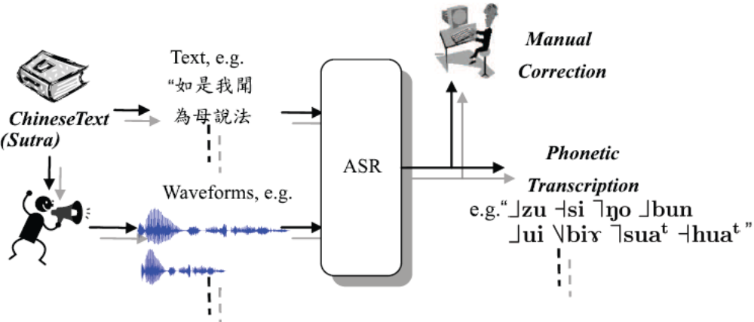
The Proposed Architecture
Through reading Buddhist Sutra, we discover which of them is actually pronounced.
We are interested in how ASR and G2P technology can help in this situation
The process of semi-automatic transcription of Chinese text into Taiwanese pronunciation using the ASR technique

Slide 4
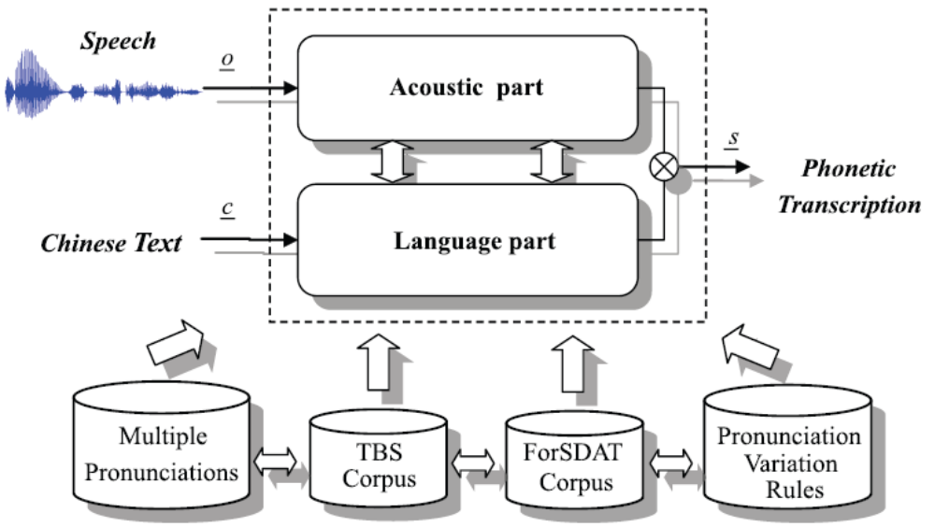
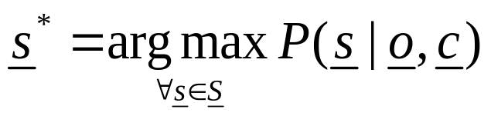
The diagram of the proposed phonetic transcription tech.
s_{i} is an arbitrary Taiwanese syllable, S is the set of all Taiwanese syllables
o_{i} is an arbitrary observation, O is the set of all observation
c_{i} is an arbitrary Chinese character, C is the set of all Chinese characters

Slide 5
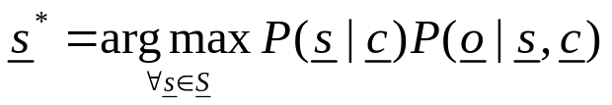
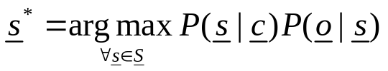
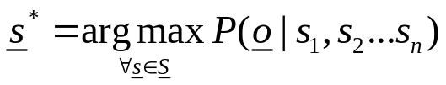
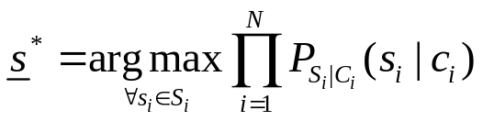
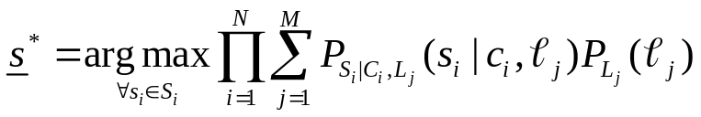
Using the Bayes theorem:
The acoustic sequence o is assumed dependent only on the syllable sequence s
Skip c
Acoustic part
Language part

Slide 6
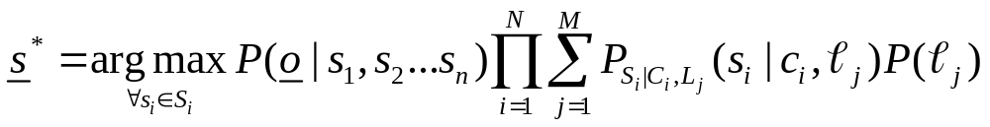
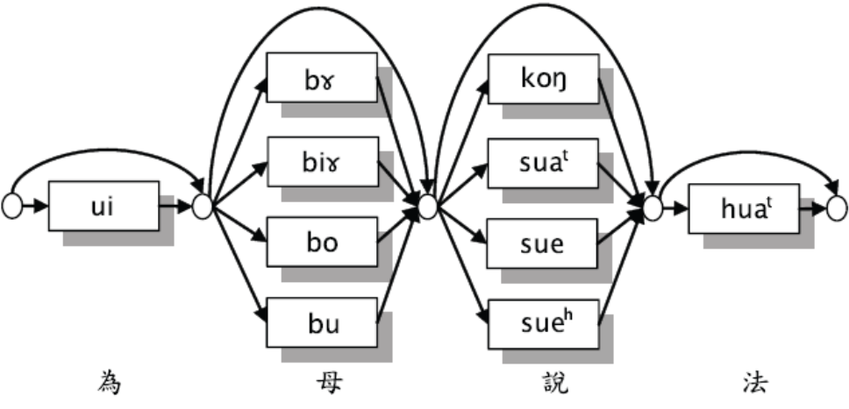
Sausage Network to solve MP problem (cont.)
What is proposed in this paper is an approach to integrate both.
The net is constructed from the multiple pronunciations of each Chinese character from our Formosa Lexicons.

Slide 7
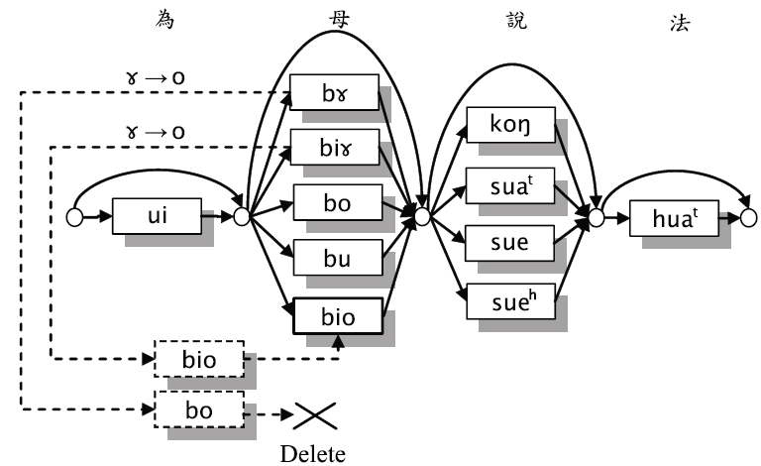
Incorporating Pronunciation Variation Rules
Expand the pronunciation lexicon using variation rules of the form LBR  LSR
where B and S represent the base form and surface form of a central phone, and L, R are the left and right contexts
An example of the extended sausage searching net. The net is constructed from the multiple pronunciations in lexicon and expanded using pronunciation-variation rules for each Chinese character according to the rule

Slide 8
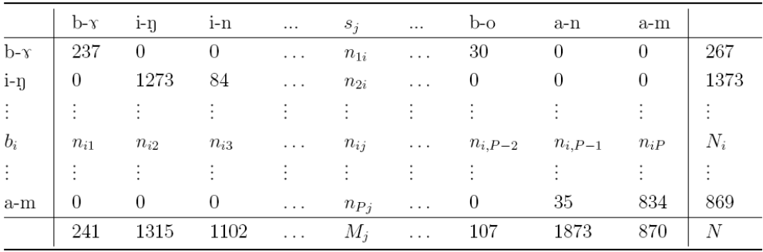
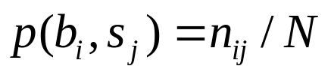
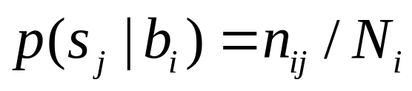
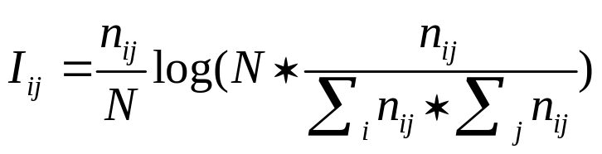
Incorporating Pronunciation Variation Rules (cont.)
Pruning rules
  Joint probability
  Conditional probability
  Mutual information

Slide 9
Database
Database
 | ForSDAT-01 | Partial ForSDAT-02
Utterance | 92158 | 19731
# of People | 100(M: 50, F: 50) | 131(M: 72, F: 59)
# of Syllables | 179730 | 45865
# of distinct triphones | 1356 | 1194
# of total triphones | 555731 | 104894
Time (min) | 1345.8 | 432
Table 1. The statistics of total ForSDAT-01 speech corpus and partially manually validated ForSDAT-02 speech corpus, where M and F denote male and female
Buddhist Corpus Category | Adaptation | Test | Other | Total
Utterance | 31 | 502 | 1086 | 1619
# of Syllable | 359 | 5909 | 12147 | 18415
Time (min) | 2.62 | 43.23 | 179.88 | 225.73
Table 2. TBS (Taiwanese Buddhist Sutra) speech corpus.

Slide 10
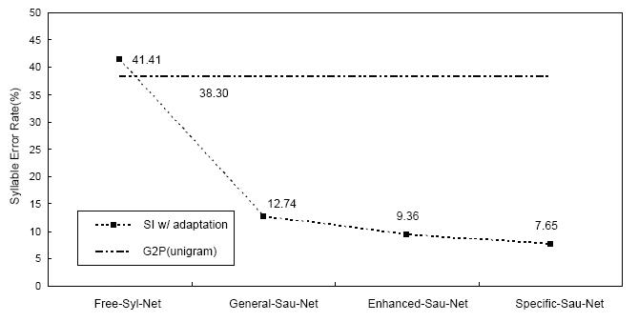
The first experiment results
Acoustic model
  Adaptive triphone model
Language model
  Sausage net built by the information of MV lexicon
Baseline

Slide 11
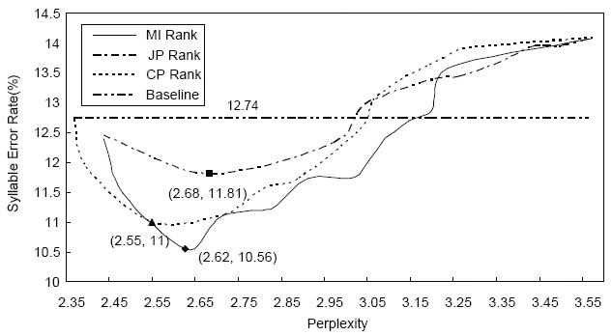
The second experiment results
Acoustic model
  Adaptive triphone model
Language model
  Sausage net incorporated by the information of MV lexicon and PV rules
The error rate of the MI rank converges most quickly and the performance of the MI method in error reduction was best

Slide 12
Discussion and Conclusion
The General-Sau-Net could compete with the Specific-Sau-Net
MI is the best in terms of the rate of decrease in SER or the achievable lowest SER
Extending the search net can enhance the SER performance, but the extension must be limited to a suitable range
By using a MP lexicon, a transcription error rate of 12.74% was achieved
The trivial adaptation of general purpose sausage net with pronunciation variation rules was used and further improvement of an error rate reduction of 17.11% could be achieved.

